Slide 1

How hot is it?
Julian L. Schmehr, Michael Aling, Eli Zoghlin, Stephen D. Wilson; High-pressure laser floating zone furnace. Rev. Sci. Instrum. 1 April 2019; 90 (4): 043906. https://doi.org/10.1063/1.5085327

Slide 2
How hot is it?
Crystal growths are temperature sensitive
How hot is the molten zone?

Slide 3
How hot is it?
Crystal growths are temperature sensitive
How hot is the molten zone?

Slide 4
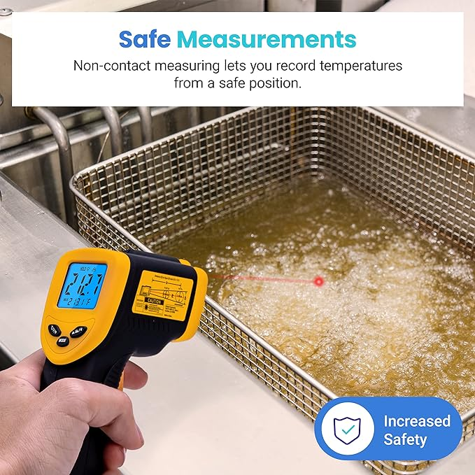
Etekcity Infrared Thermometer Temperature Gun 774, Digital IR Temp Gun for Food, Cooking, BBQ, Pizza Oven, Reptile, Griddle Accessories, Non Contact Surface Outdoor Heat Gun

Slide 5
Pyrometry: Temperature from Radiation

Slide 6
Pyrometry: Temperature from Radiation
Infrared Pyrometers:
Funnel infrared radiation into detector
Measure incoming intensity
Calculate temperature

Slide 7
Pyrometry: Temperature from Radiation
Infrared Pyrometers:
Funnel infrared radiation into detector
Measure incoming intensity
Calculate temperature

Slide 8
Pyrometry: Temperature from Radiation
Infrared Pyrometers:
Funnel infrared radiation into detector
Measure incoming intensity
Calculate temperature

Slide 9
Pyrometry: Temperature from Radiation
Infrared Pyrometers:
Funnel infrared radiation into detector
Measure incoming intensity
Calculate temperature

Slide 10
Measuring more than Infrared

Slide 11
Measuring more than Infrared
Traditional camera

Slide 12
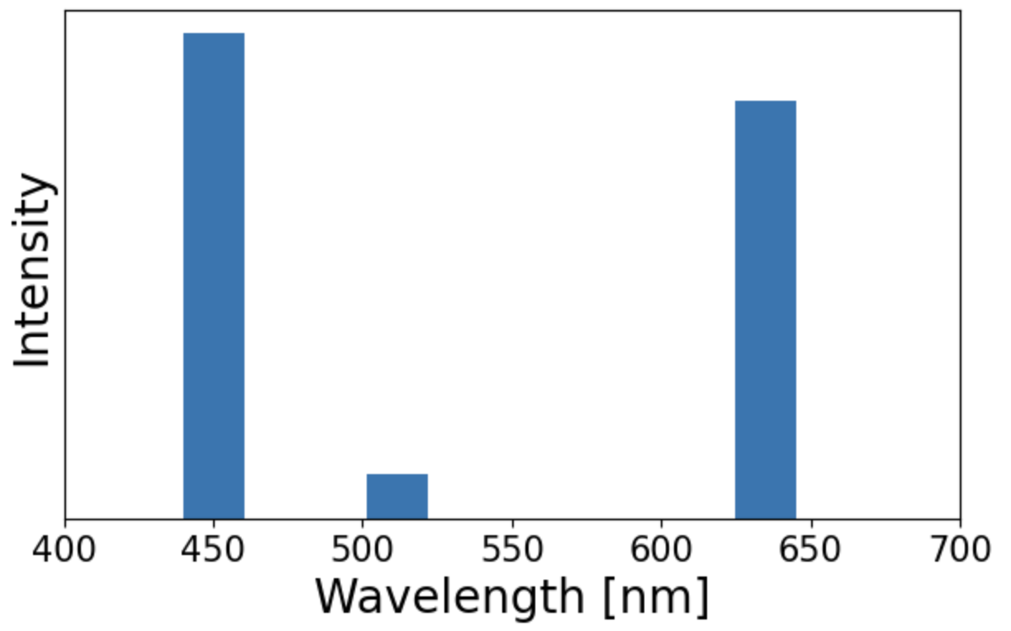
Measuring more than Infrared
Traditional camera

Slide 13

Measuring more than Infrared
Traditional camera

Slide 14
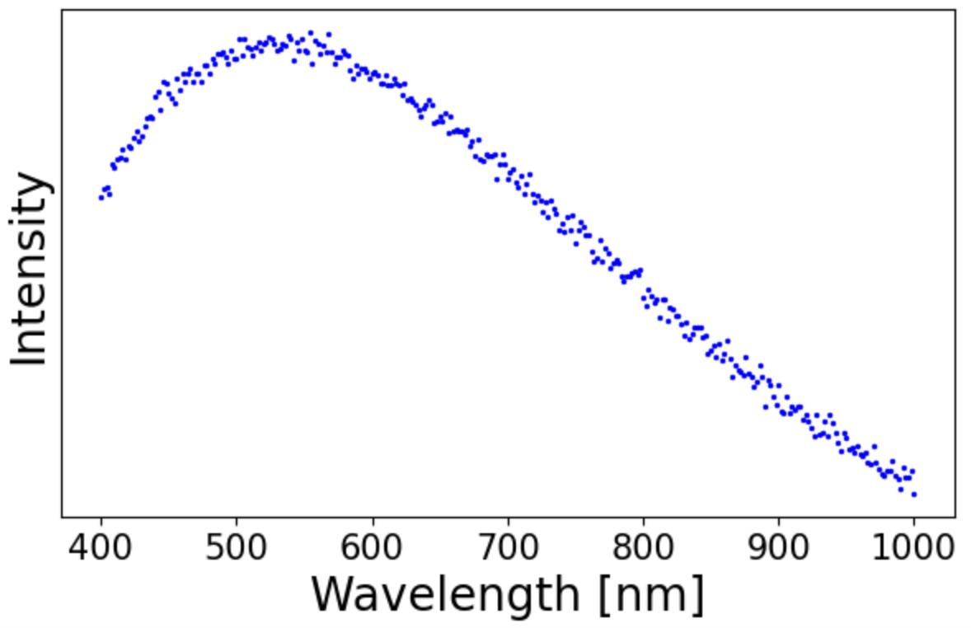
Measuring more than Infrared
Hyperspectral camera

Slide 15
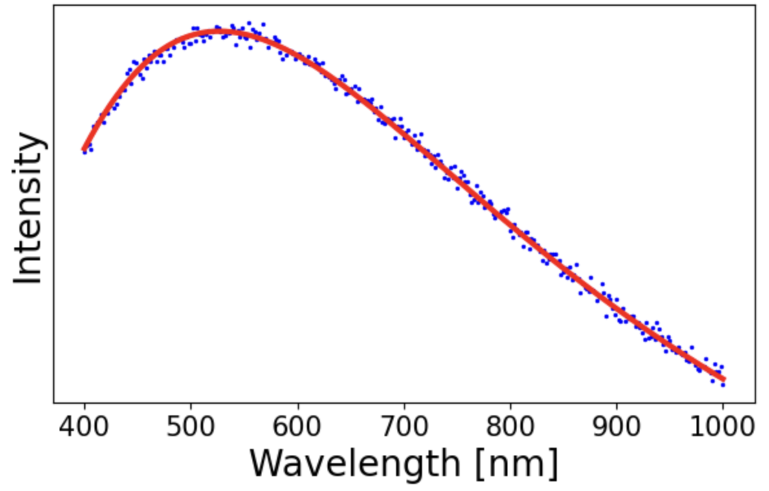
Measuring more than Infrared
Hyperspectral camera

Slide 16
Measuring more than Infrared
Hyperspectral camera
5500 K

Slide 17
Fitting to a Blackbody

Slide 18
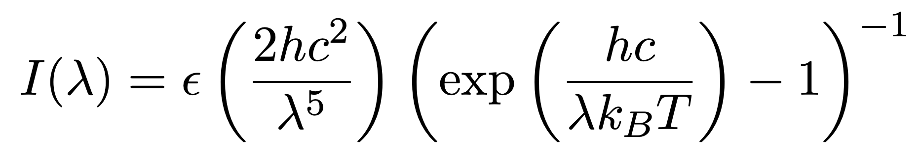
Fitting to a Blackbody

Slide 19
Fitting to a Blackbody
ε: emissivity
T: temperature (what we want!)

Slide 20
Fitting to a Blackbody
ε: emissivity
T: temperature (what we want!)

